Slide 1
Apache Spark

Slide 2
Apache Spark
Apache Spark is a cluster computing platform on top of a storage layer.
It extends MapReduce with support for more types of components such as streaming and interactive analytics.
Spark offers the ability to run computations in memory, but is also more efficient than MapReduce for running on disk

Slide 3
Why Spark ?
Reliable In-memory Processing
In-memory data sharing across DAGs make it possible for different jobs to work with the same data quickly
Iterative algorithms are faster as data is not being written to disk between jobs
Spark processes data 10 times faster than MapReduce on disk and 100 times faster in memory
Unified stack
Multi language support

Slide 4
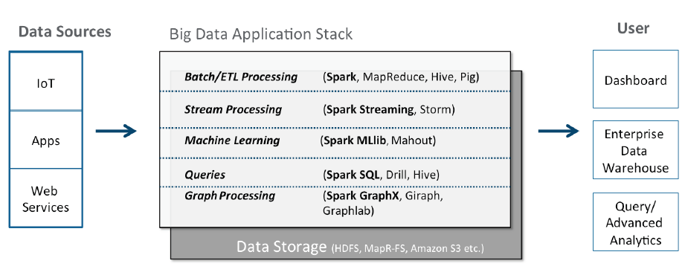

Slide 5
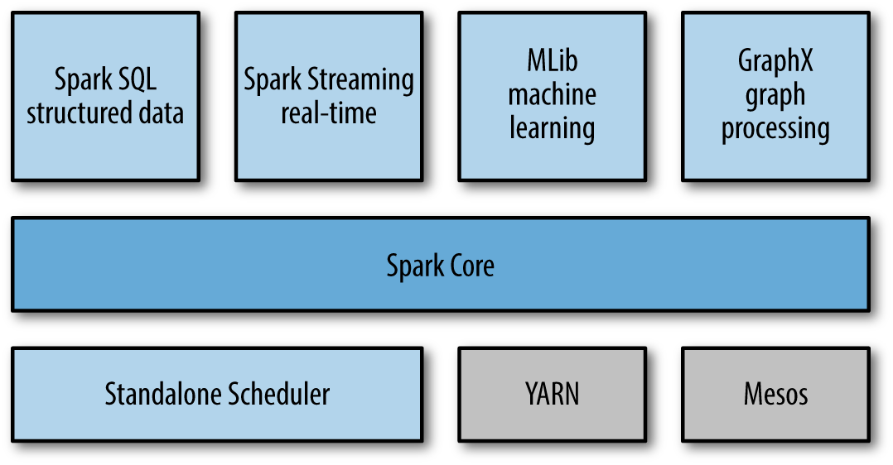
Spark Stack

Slide 6
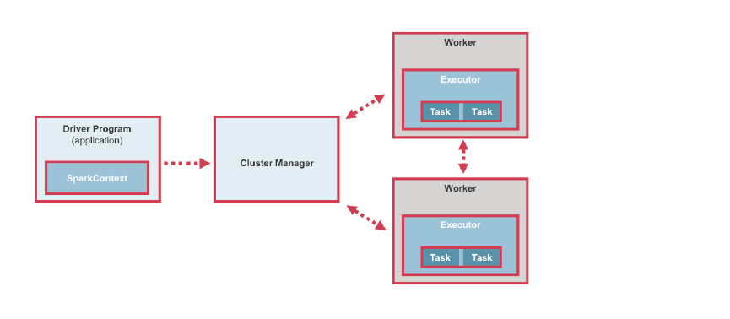
Spark Core – Execution flow

Slide 7
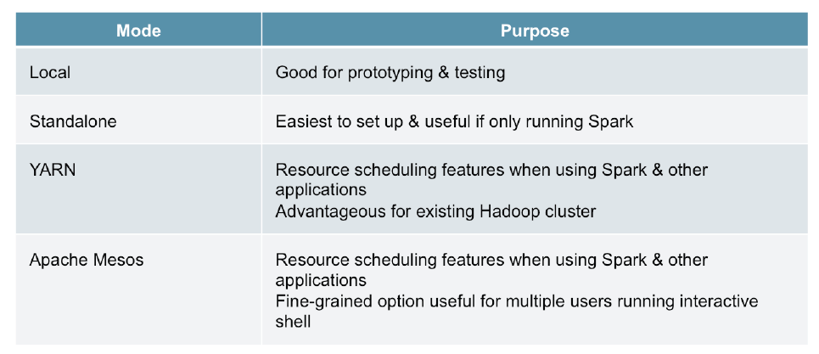
Deploy Modes
Client
Clustered

Slide 8
Loading data in Spark
File formats and File system
Structured data sources – Spark SQL
Databases and Key Value pairs
Lab Activity – Load data from Hive/mysql

Slide 9
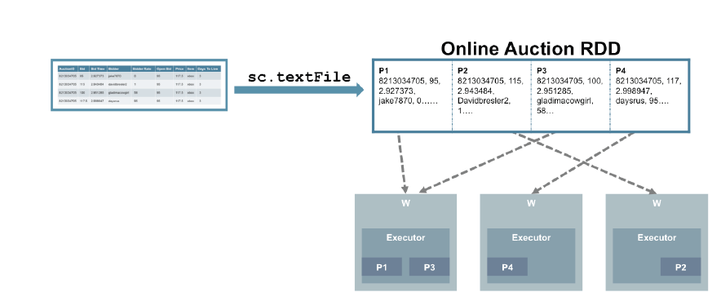
Resilient Distributed Datasets
Primary Data abstraction in Spark
Collection of Objects distributed across nodes
Immutable

Slide 10
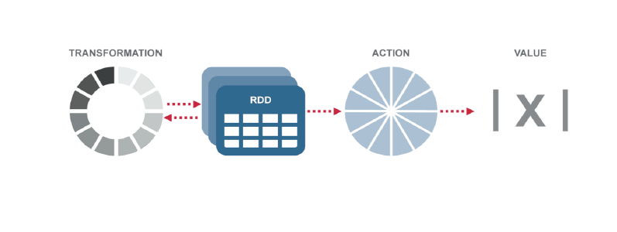
RDD Operations
Transformation
Action
Lazy Evaluation
Passing Functions to Spark
Persistence/Caching of Intermediate data

Slide 11
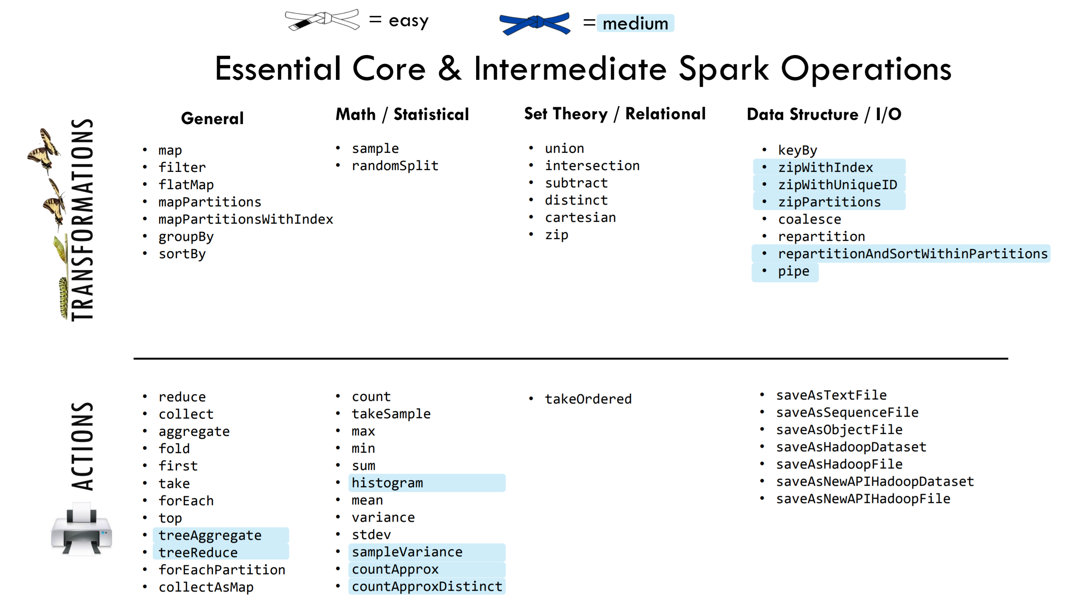
Common Transformations

Slide 12
Key Value Pairs
Creating Paired RDD
Transformations on Pair RDDs
Actions on Pair RDDs
Data Partitioning
Custom Partitioner
Lab Activities

Slide 13
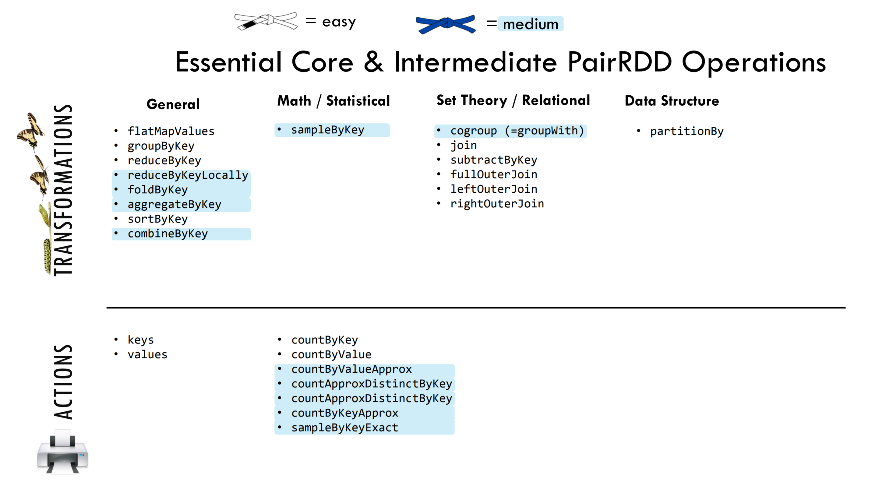
Common Operations

Slide 14
Data Partitioning
Hash Partitioner
Range Partitioner
Significance of partitioning in transformations
Repartition

Slide 15
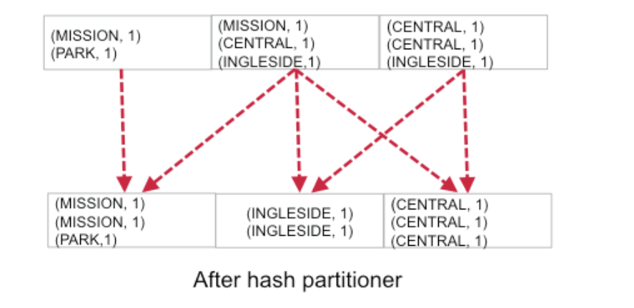
Hash Partitioning

Slide 16
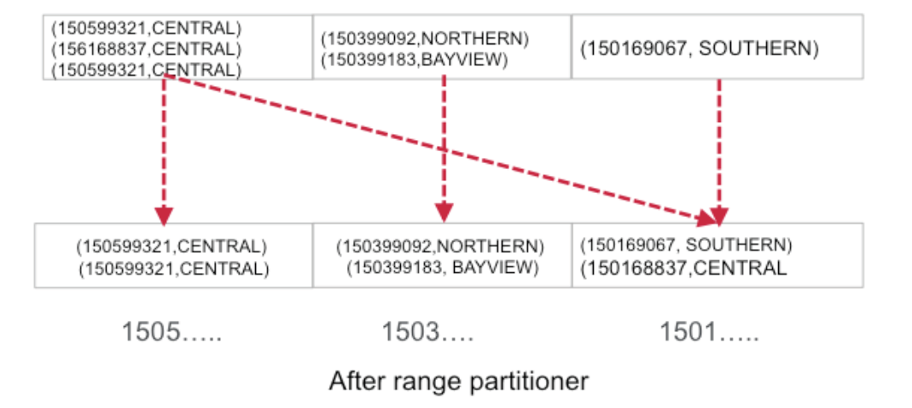
Range Partitioning

Slide 17
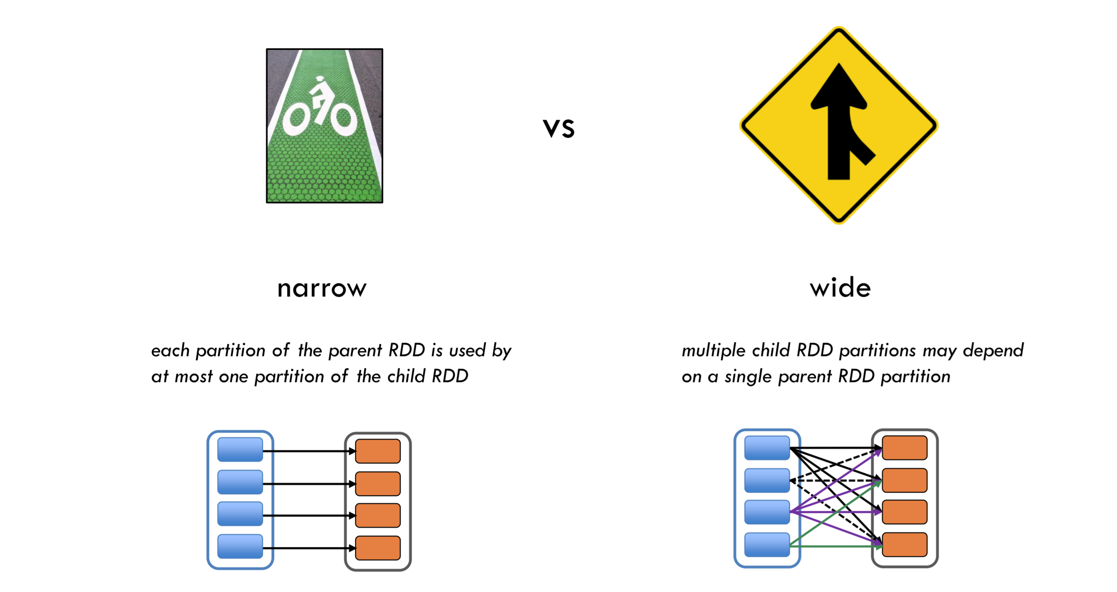
Significance of Partitioning

Slide 18
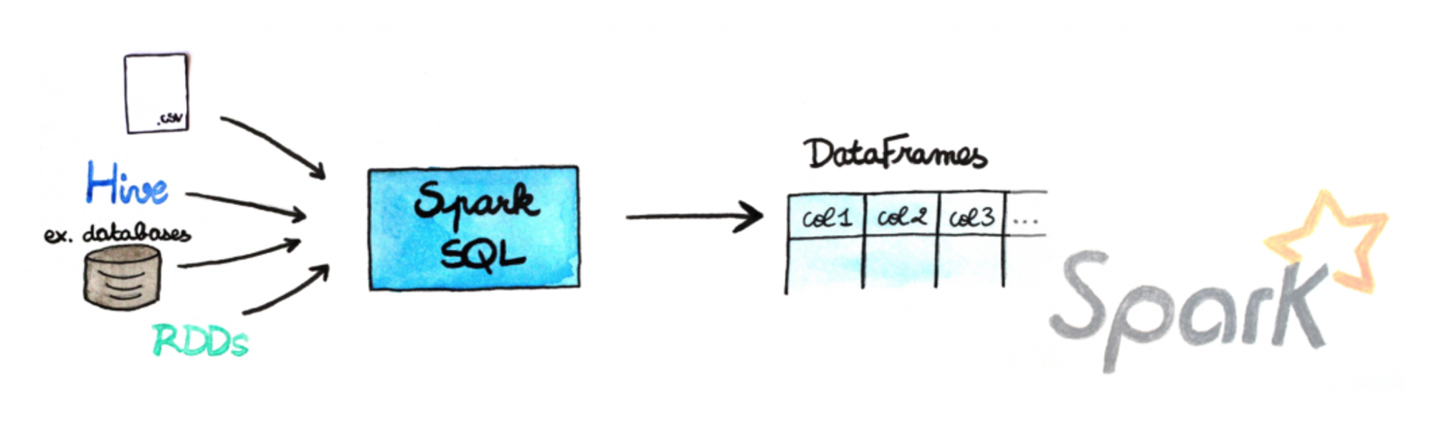
Data frames
Distributed collection of data organized into named columns
Equivalent to Table in RDMBS
SQL like interface on RDDs
Optimized

Slide 19
Dataframe - Operations
Dataframe Actions
Dataframe Functions
Create UDF
Partitions in Data frames
Lab Activities

Slide 20
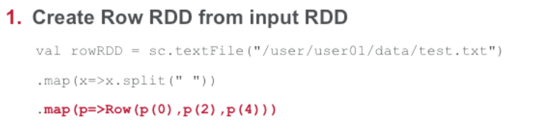
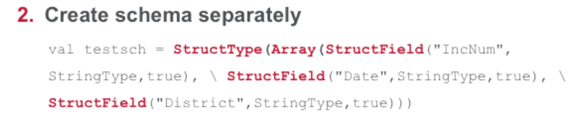
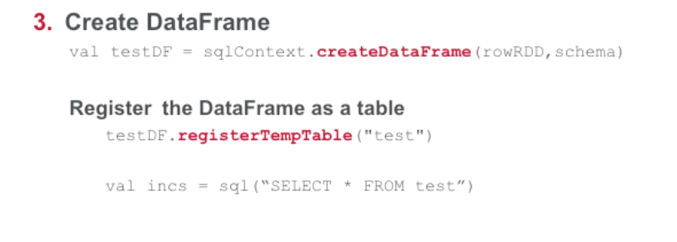

Slide 21
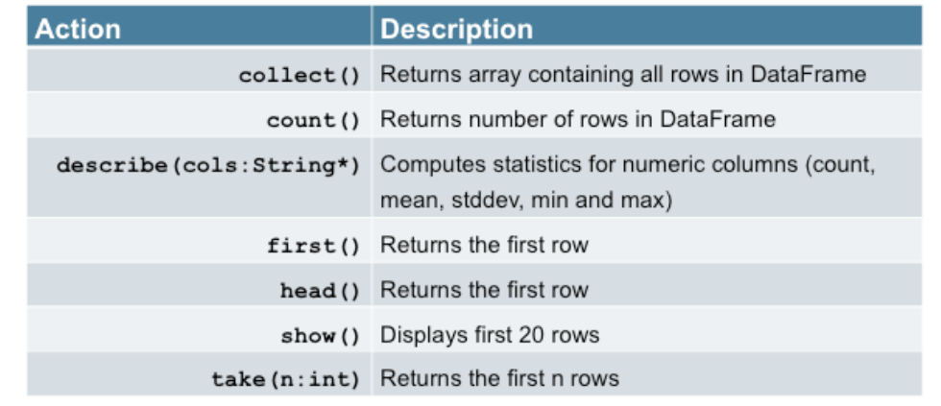
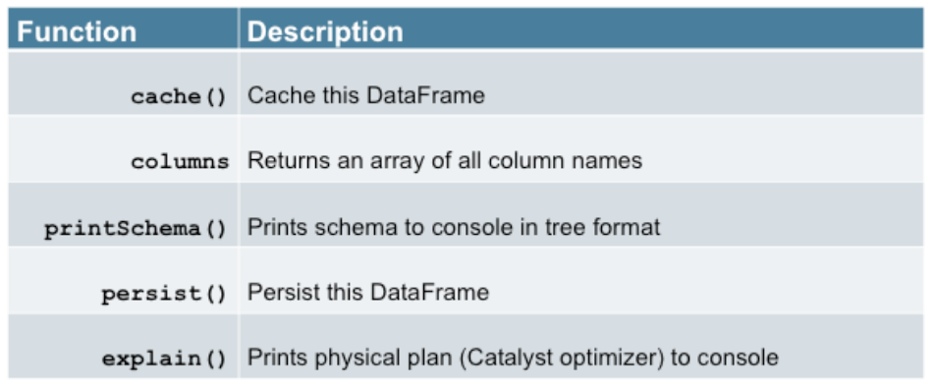

Slide 22
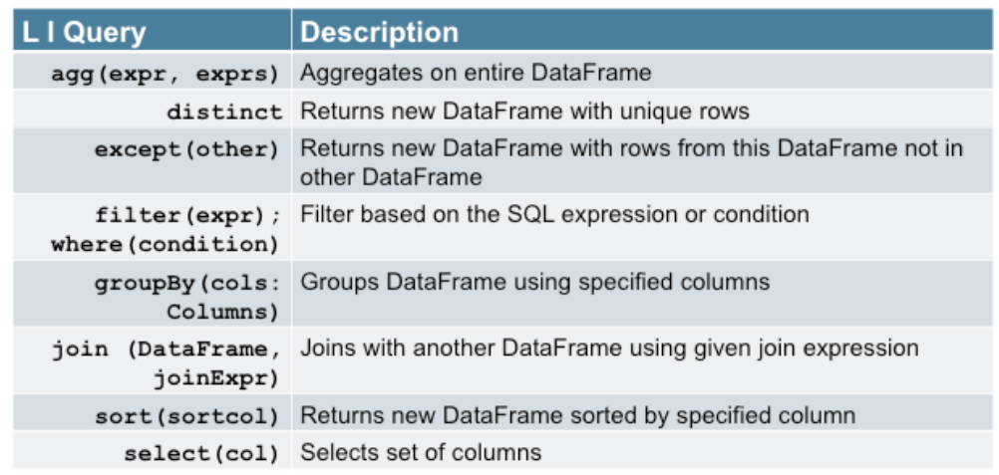
Other Integrated Queries

Slide 23
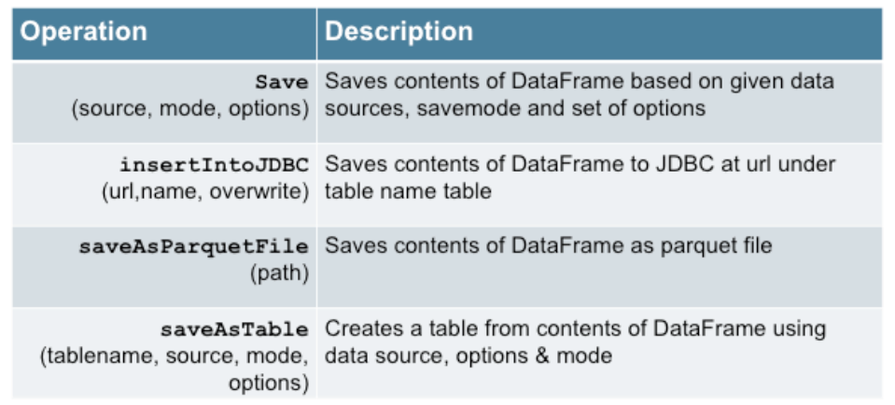
Save Operations

Slide 24
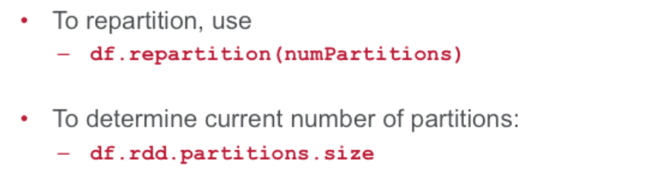
Partition Data frames

Slide 25
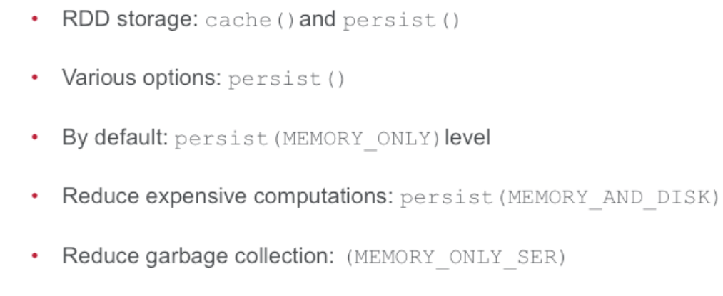
Performance : Tuning Memory usage

Slide 26
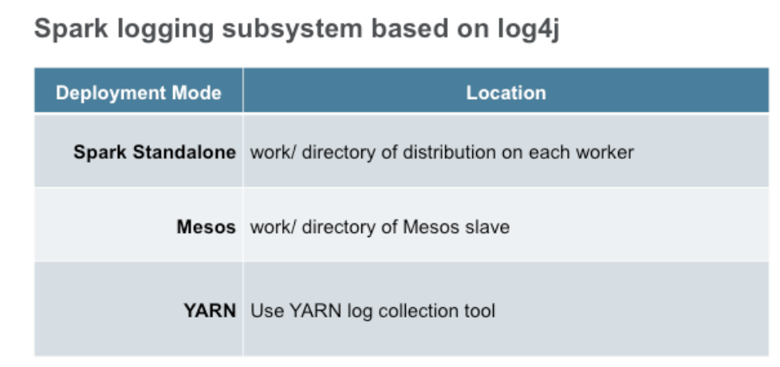
Logging

Slide 27
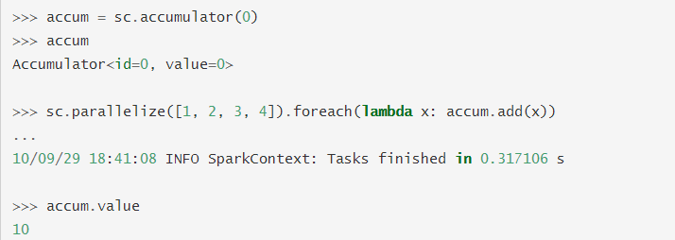
Accumulators
Accumulators are variables that are "added" to through an associative and commutative operation
Similar to Counters in Map Reduce
Accumulator are write-only variables for executors. They can be added to by executors
and read by the driver only.
Accumulators are not
thread-safe

Slide 28
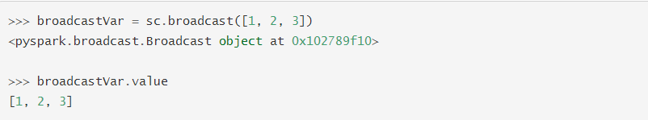
Broadcast Variables
Read-only variables cached on each machine
Spark distribute broadcast variables using efficient broadcast algorithms at each stage to reduce communication cost
Can be accessed by “value” method
Shipped to nodes only once

Slide 29
Spark Streaming
Process data in real time
Fast batch-processing system
Collects data stream into small batch to process it
Batches are called as Dstream

Slide 30
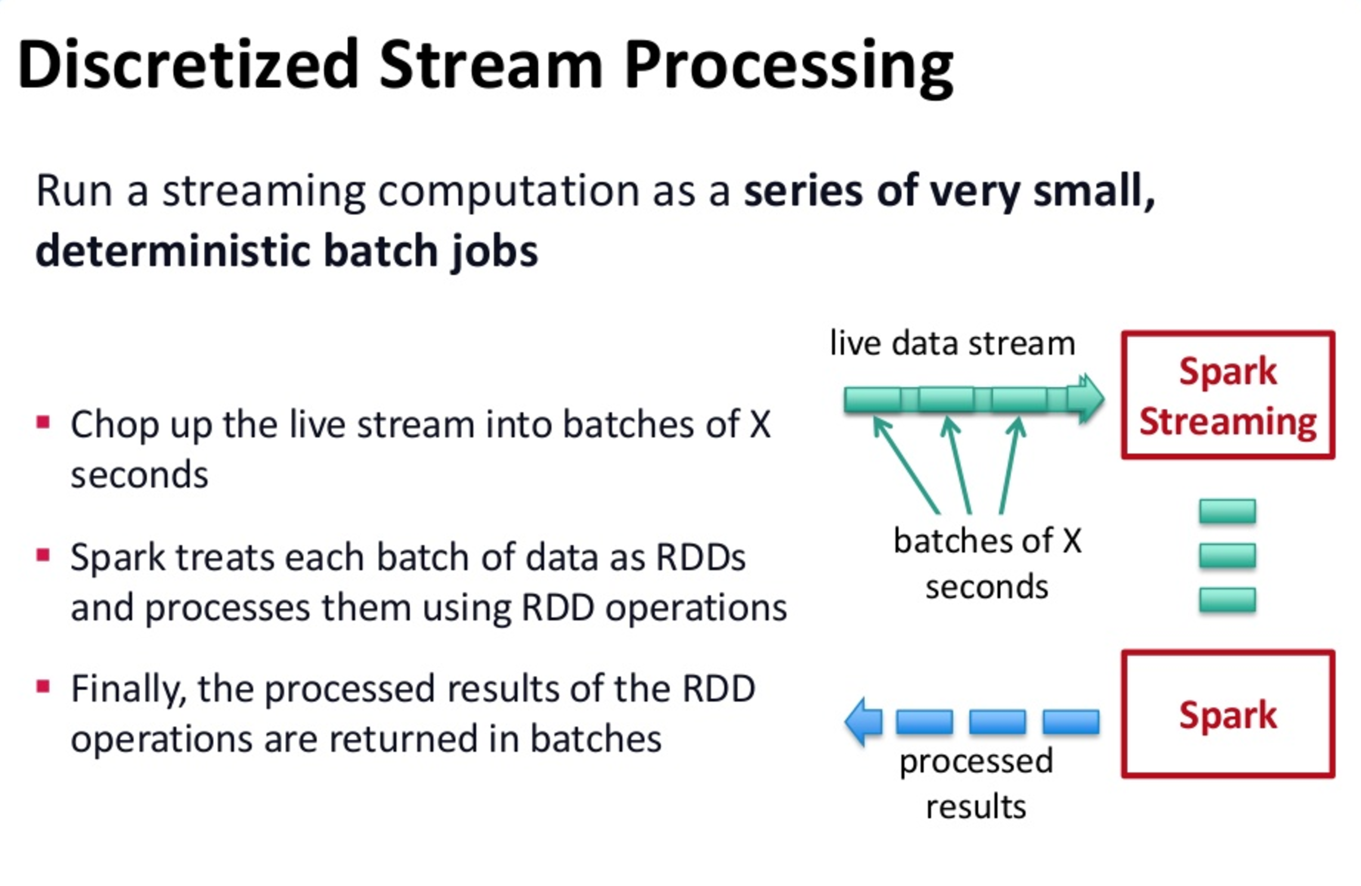

Slide 31
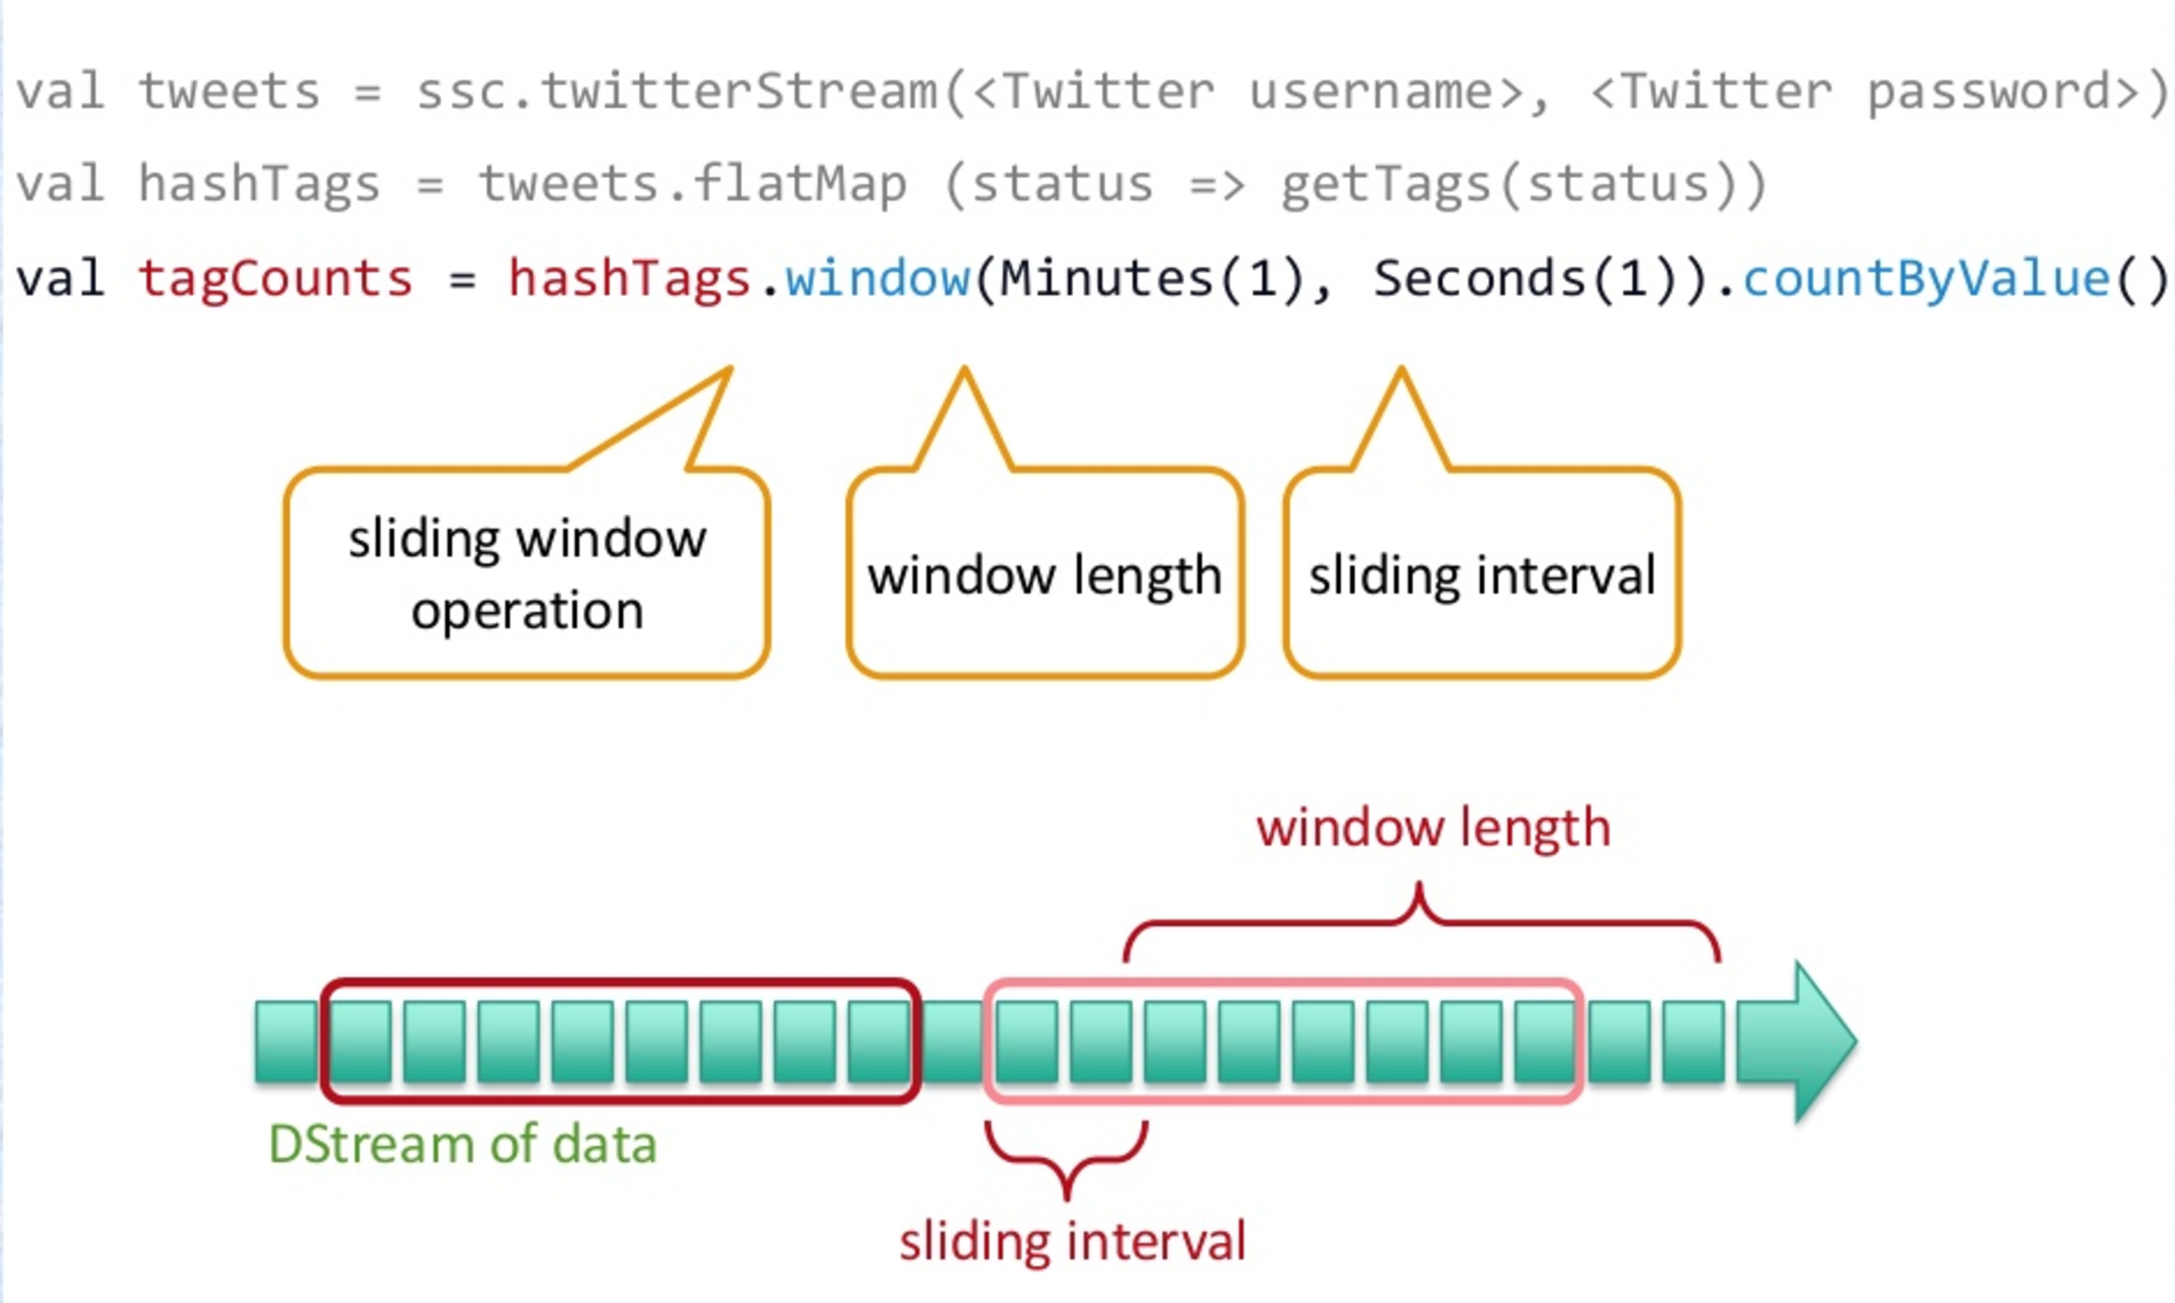
Example

Slide 32
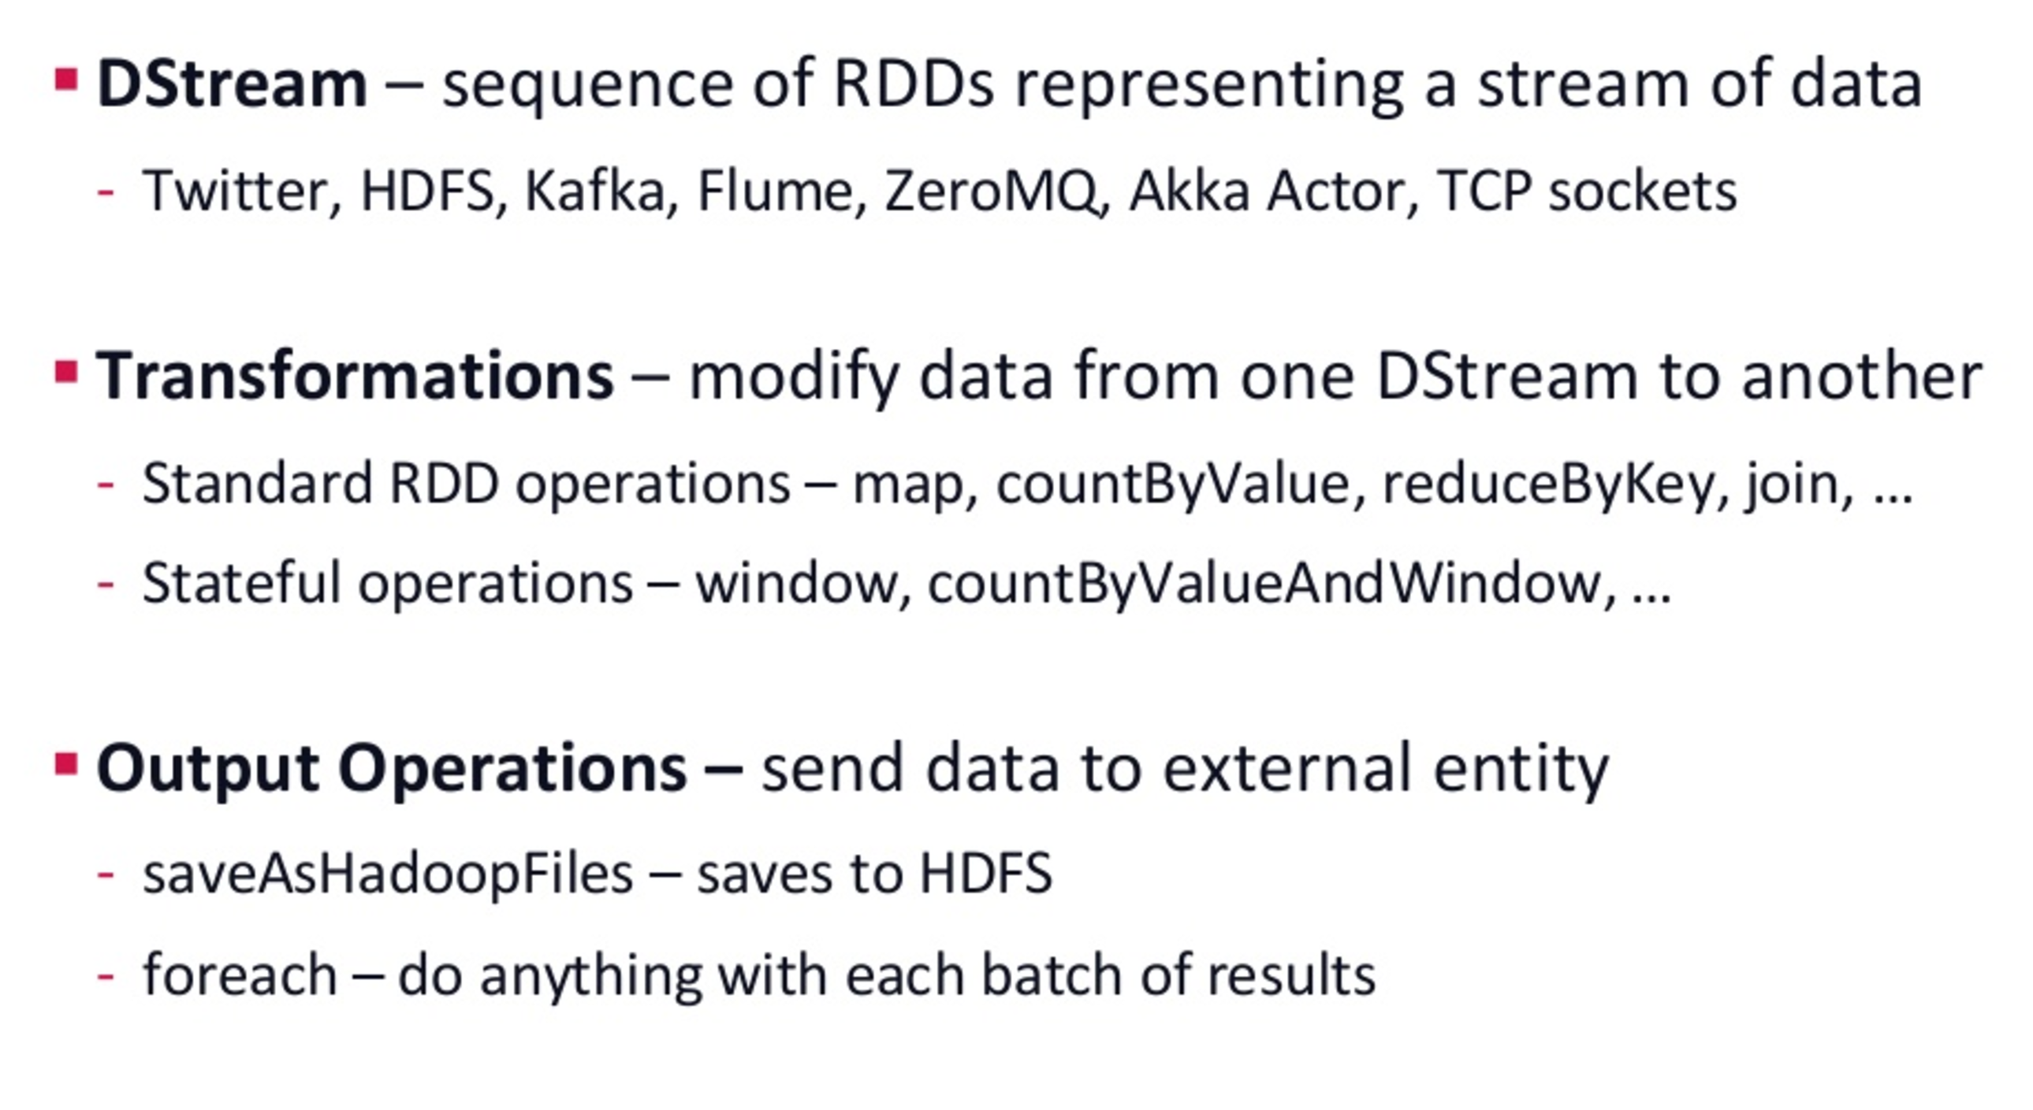
Key Concepts

Slide 33
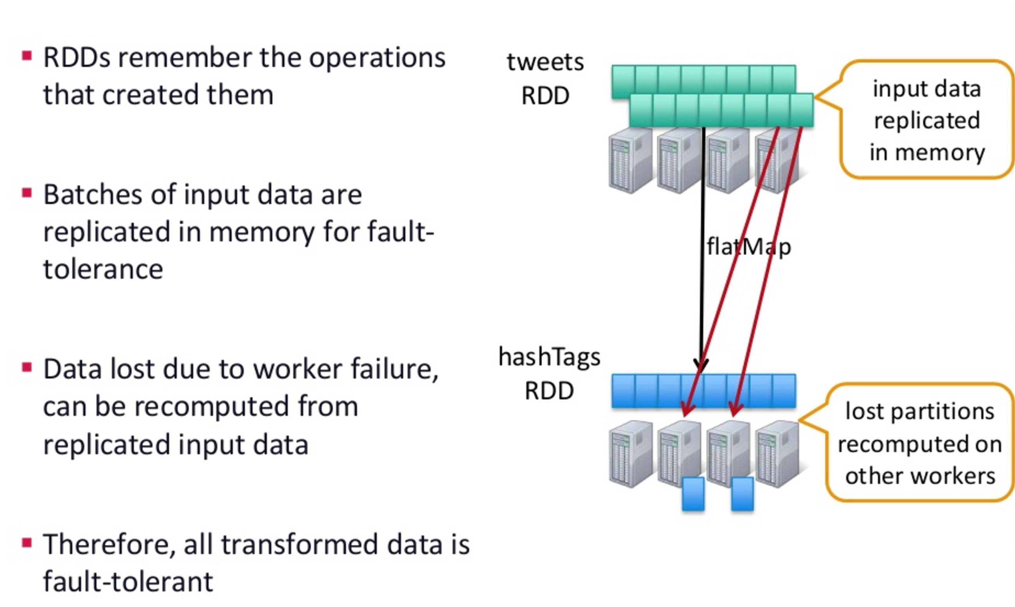
Fault-tolerance

Slide 34
DStream
Sequence of RDD representing stream
Dstream interface defines how to generate RDD in each batch
List of Dependents
Slide interval
Computation function

Slide 35
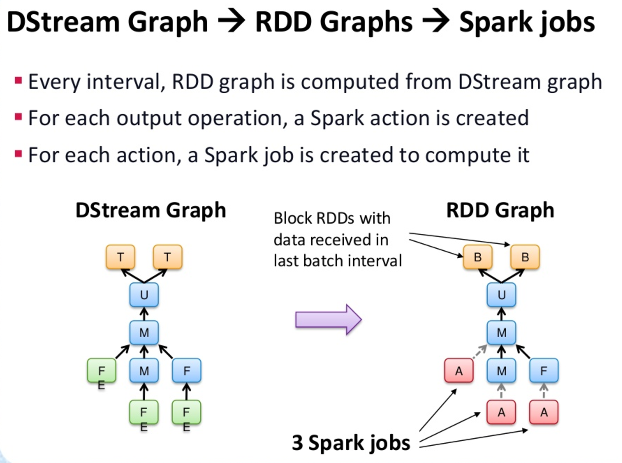
Dstream Graph

Slide 36
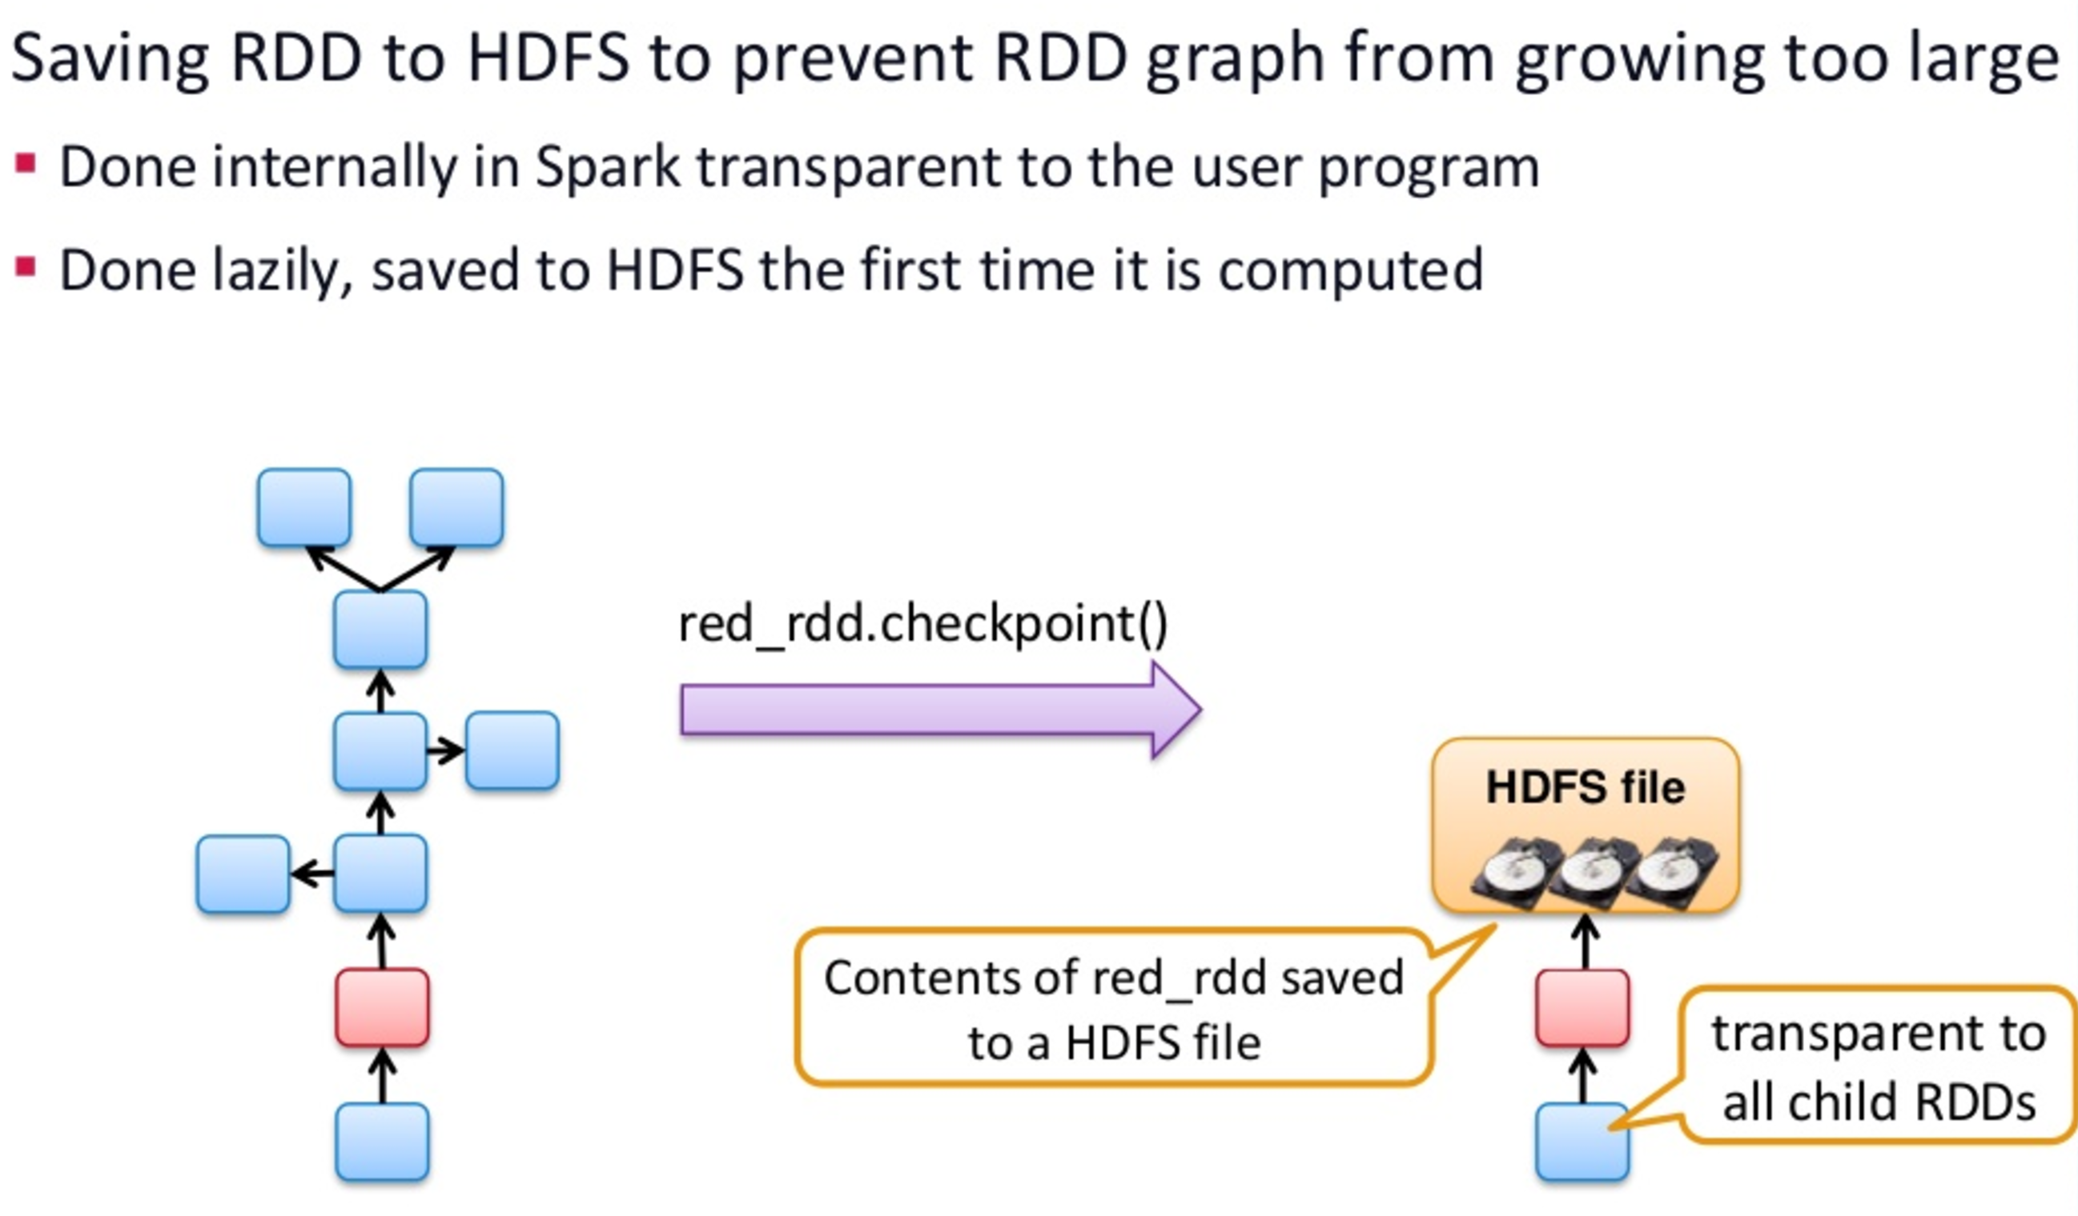
RDD Checkpointing

Slide 37
Lab
Streaming app based on HDFS

Slide 38
References
https://spark.apache.org/docs/latest/programming-guide.html
https://spark.apache.org/docs/1.5.0/api/python/_modules/pyspark/
http://learn.mapr.com/ess-360-apache-spark-essentials
https://jaceklaskowski.gitbooks.io/mastering-apache-spark/content/spark-rdd-partitions.html

Slide 39
Thank You

